Slide 1
IBM
TEAM ID :PNT2022TMID12757

Slide 2




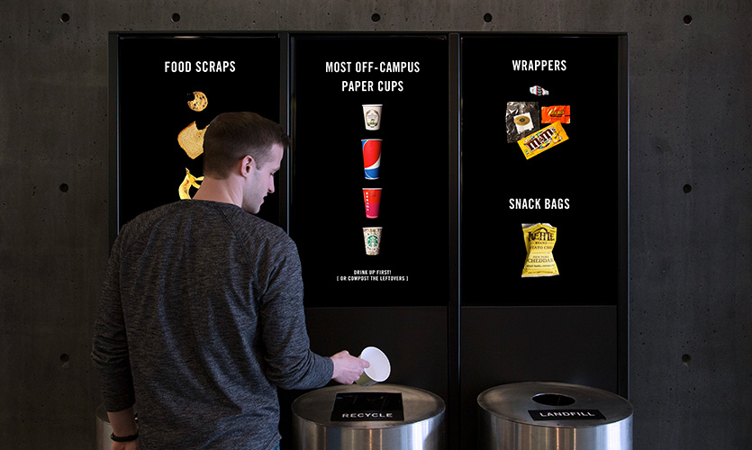


GSM
CONTROLLER
I’m full!!
Notes:
TEAM ID :PNT2022TMID12757

